Slide 1
Home IoT System
WES237A Final Project

Slide 2
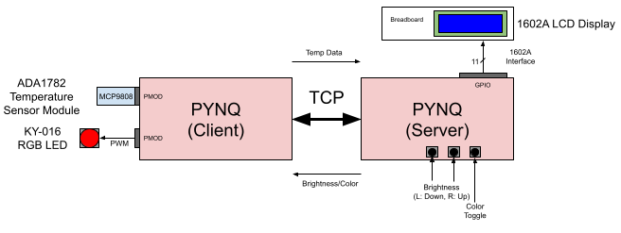

Slide 3
Topics Covered
I/O: PWM with RGB LED, Arduino GPIO using LCD display (personal libraries), I2C interface, pushbuttons, PMOD using Microblaze
Rotary encoder, originally
Local communication: I2C interface, LCD interface
Networking: TCP connection, bidirectional data flow
Threading: Multiple threads on both client and server for handling data relay tasks in parallel

